Slide 1
Securing understanding of arithmetic procedures with integers and decimals
Arithmetic procedures with integers and decimals

Slide 2
how to use Oak lessons

Slide 3
I can add, subtract, multiply and divide with integers and decimals using a calculator to check.

Slide 4
decimal form

Slide 5
A number is in decimal form when the decimal point is shown and there are digits to the right of the decimal point.

Slide 6

Securing understanding of arithmetic procedures with integers and decimals
Using a calculator for integer calculations
Using a calculator for decimal calculations

Slide 7

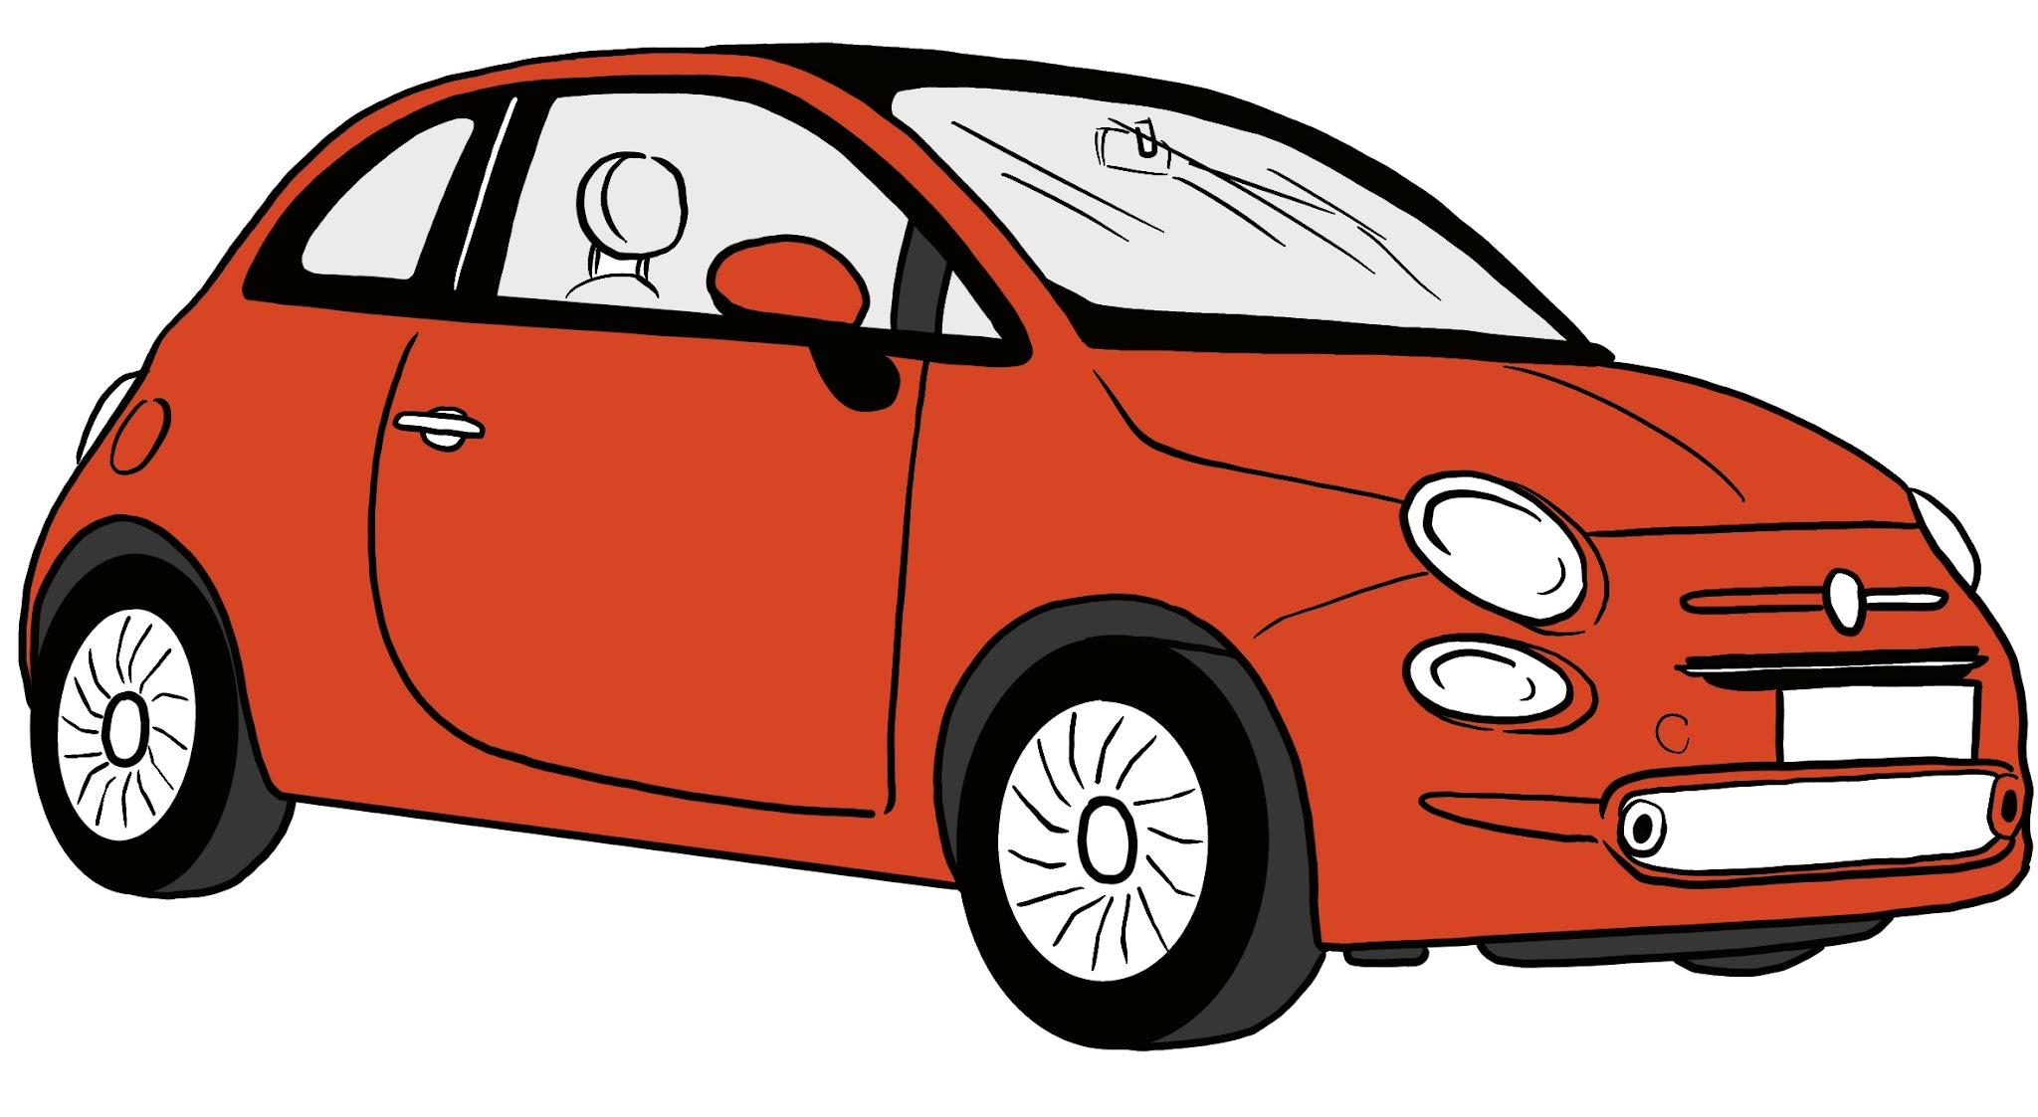
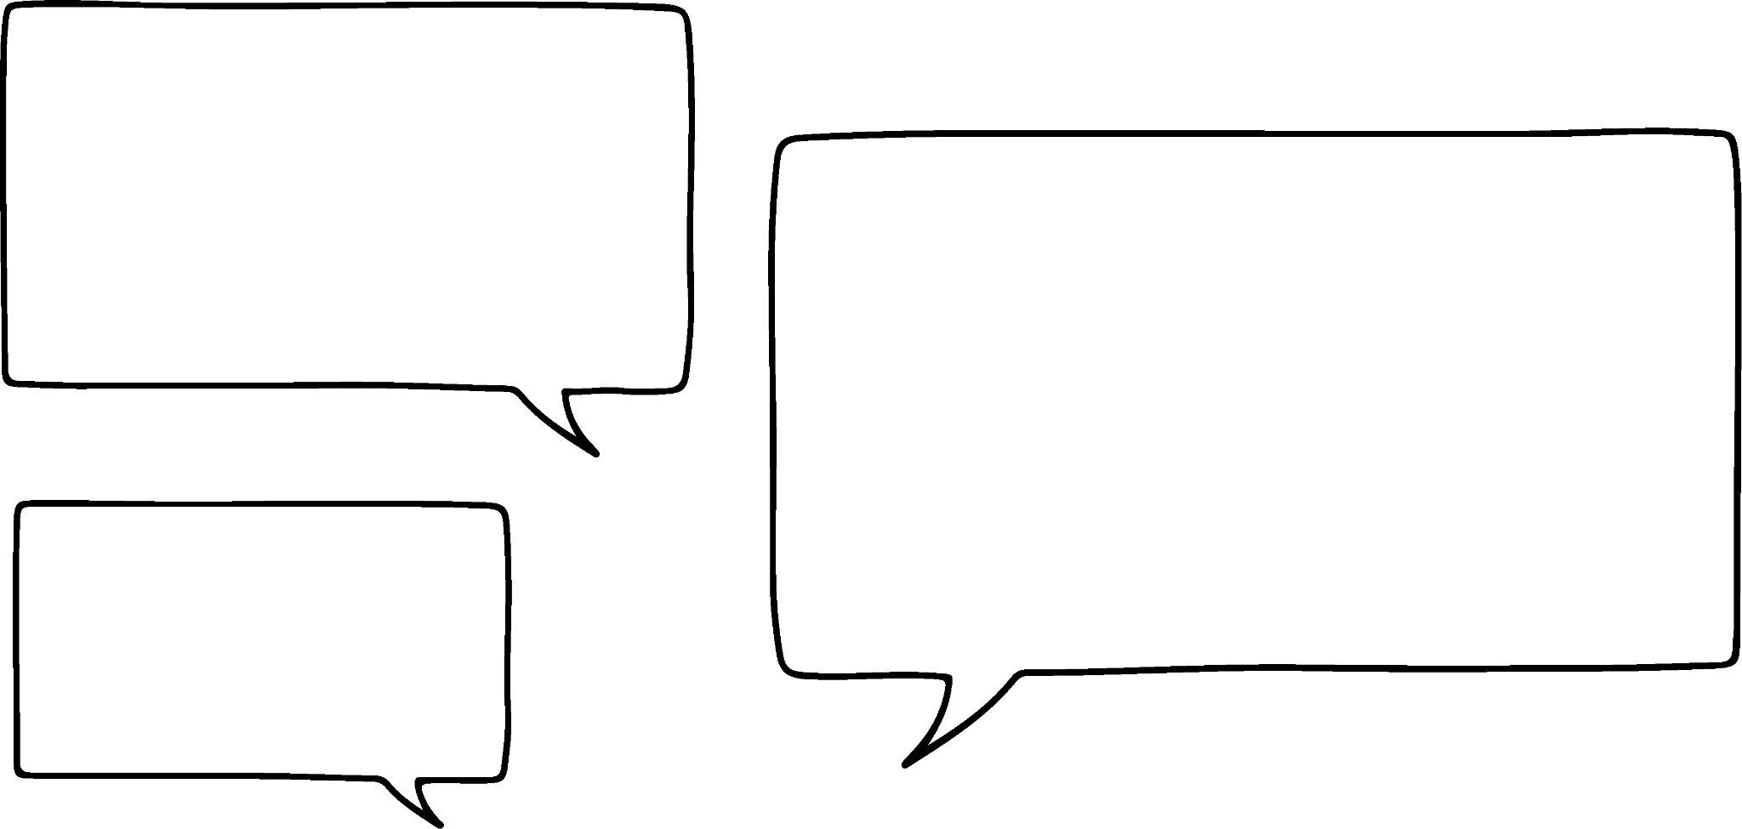



Using a calculator for integer calculations
What is the total cost of the car and house?
£16 790
£265 100
Sofia, Jacob and Laura each work out the answer to this question.
They each claim they must be right as they used a calculator.
Without calculating, can you tell who is right?
Actually it’s £281 890
It’s £266 779
No, it’s £43 300

Slide 8
Using a calculator for integer calculations
What is the total cost of the car and house?
£16 790
£265 100
Car is close to £17 000 and the house is close to £300 000
The total of those is £317 000
Sofia and Laura’s answers look like they could be right.
Both costs have a zero in the ones column so it must end in zero.
Actually it’s £281 890
It’s £266 779
No, it’s £43 300
Laura is right

Slide 9
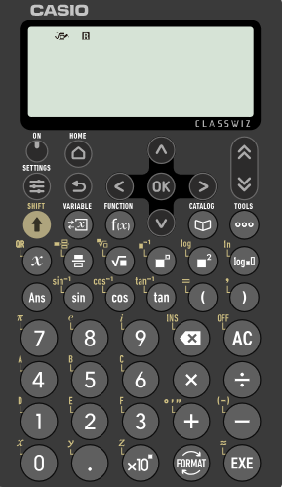
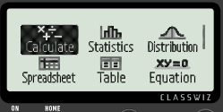

Using a calculator for integer calculations
What is the total cost of the car and house?
£16 790
£265 100
Here is the Casio fx-991EX.
Firstly, ensure ‘Calculate’ is highlighted.
Then press ‘EXE’.

Slide 10
Using a calculator for integer calculations
What mistake do you think Sofia has made?
£16 790
£265 100
It’s £266 779

Slide 11
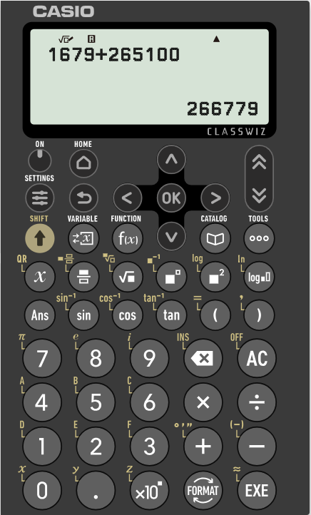
Using a calculator for integer calculations
Here is Sofia’s calculator display.
What was her mistake?
£16 790
£265 100
She has missed the zero off the end of 16 790
It’s £266 779

Slide 12
Using a calculator for integer calculations
What is the total cost of the car and house?
Can you spot Jacob’s mistake?
£16 790
£265 100
No, it’s £43 300

Slide 13
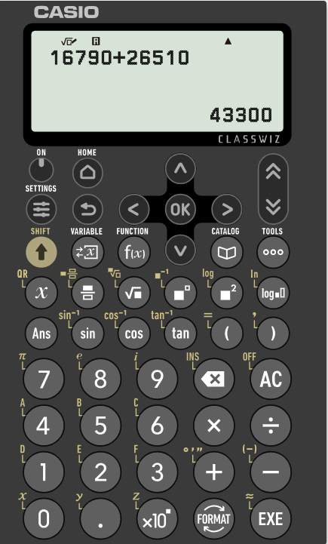
Using a calculator for integer calculations
Here’s his calculator display.
What was his mistake?
£16 790
£265 100
He has missed a zero off the end of 265 100
Always double check the calculation you have inputted.
No, it’s £43 300

Slide 14

Using a calculator for integer calculations
Which of these will be closest to the value of 43 872 − 245
400
400 000
40 000
4000

Slide 15
Using a calculator for integer calculations
Without a calculator, decide which of the following is the correct answer to 320 000 + 96 540
128 540
416 540
3 296 540
329 640

Slide 16
Using a calculator for integer calculations
Find one answer in each row which is the only possible correct answer to the question. Each square covers a single digit.
Question | Answer 1 | Answer 2 | Answer 3
⬛ 3 8 + 4 ⬛ ⬛ | 7 ⬛ | ⬛ 3 ⬛ | 7 ⬛ ⬛ 4
5 ⬛ 8 ⬛ + ⬛ 8 ⬛ 4 | 8 ⬛ ⬛ 1 | 5 4 ⬛ 9 ⬛ | 8 ⬛ 1
⬛ 53 ⬛ + 1 ⬛ 5 ⬛ 2 | ⬛ 3 9 9 | 2 ⬛ ⬛ 0 9 9 | ⬛ 3 ⬛ 9 9
4 3 ⬛ ⬛ 2 + ⬛ 8 6 | 4 ⬛ ⬛ 8 | ⬛ 4 ⬛ 5 | 4 ⬛ ⬛ 2 ⬛
⬛ ⬛ 7 − ⬛ ⬛ 6 | 4 ⬛ ⬛ | ⬛ 3 3 ⬛ | ⬛ 3
⬛ 2 ⬛ 6 − 4 ⬛ ⬛ | 9 ⬛ ⬛ 0 9 | ⬛ 0 0 ⬛ | 9 ⬛ 9
⬛ ⬛ 6 ⬛ 4 − ⬛ 9 ⬛ ⬛ | 3 3 ⬛ 2 | ⬛ 3 ⬛ 6 ⬛ 2 | ⬛ 3 ⬛ ⬛ 2
A
I
B
R
C
A
D
R
E
O
M
E
T
W
H
S
G
F
P
L
N
Rearrange the letters of the correct answers to make a word.

Slide 17
Using a calculator for integer calculations
Find one answer in each row which is the only possible correct answer to the question. Each square covers a single digit.
Question | Answer 1 | Answer 2 | Answer 3
⬛ 3 8 + 4 ⬛ ⬛ | 7 ⬛ | ⬛ 3 ⬛ | 7 ⬛ ⬛ 4
5 ⬛ 8 ⬛ + ⬛ 8 ⬛ 4 | 8 ⬛ ⬛ 1 | 5 4 ⬛ 9 ⬛ | 8 ⬛ 1
⬛ 53 ⬛ + 1 ⬛ 5 ⬛ 2 | ⬛ 3 9 9 | 2 ⬛ ⬛ 0 9 9 | ⬛ 3 ⬛ 9 9
4 3 ⬛ ⬛ 2 + ⬛ 8 6 | 4 ⬛ ⬛ 8 | ⬛ 4 ⬛ 5 | 4 ⬛ ⬛ 2 ⬛
⬛ ⬛ 7 − ⬛ ⬛ 6 | 4 ⬛ ⬛ | ⬛ 3 3 ⬛ | ⬛ 3
⬛ 2 ⬛ 6 − 4 ⬛ ⬛ | 9 ⬛ ⬛ 0 9 | ⬛ 0 0 ⬛ | 9 ⬛ 9
⬛ ⬛ 6 ⬛ 4 − ⬛ 9 ⬛ ⬛ | 3 3 ⬛ 2 | ⬛ 3 ⬛ 6 ⬛ 2 | ⬛ 3 ⬛ ⬛ 2
A
I
B
R
C
A
D
R
E
O
M
E
T
W
H
S
G
F
P
L
N
INTEGER
Rearrange the letters of the correct answers to make a word.

Slide 18
Securing understanding of arithmetic procedures with integers and decimals
Using a calculator for integer calculations
Using a calculator for decimal calculations

Slide 19

Using a calculator for decimal calculations
Andeep buys 3 pens, 4 pencils and 2 highlighters.
He says it is going to cost him £311.22
Do you think Andeep is right?
£1.56
76p
£1.27
How have you made your decision?
What mistake do you think he has made?

Slide 20
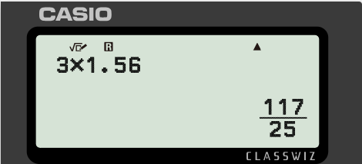
Using a calculator for decimal calculations
Andeep buys 3 pens, 4 pencils and 2 highlighters.
Cost of pens
3 × 1.56
£1.56

Slide 21
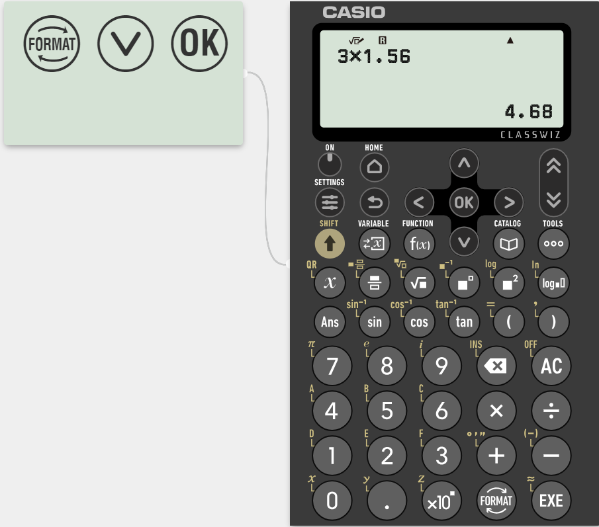
Using a calculator for decimal calculations
We need to change this into a decimal.

Slide 22
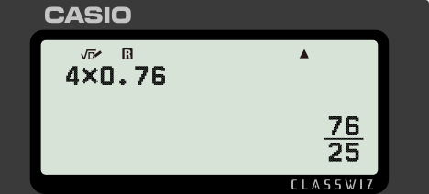
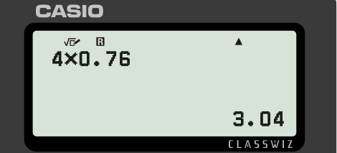
Using a calculator for decimal calculations
Andeep buys 3 pens, 4 pencils and 2 highlighters.
Cost of pencils
We need to make sure the price is in pounds.
4 × 0.76
76p

Slide 23
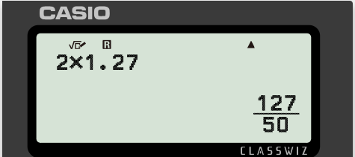
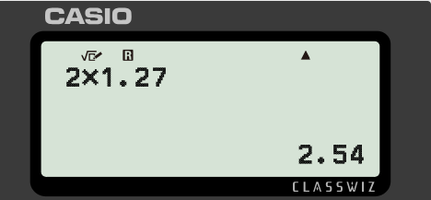
Using a calculator for decimal calculations
Andeep buys 3 pens, 4 pencils and 2 highlighters.
Cost of highlighters
2 × 1.27
£1.27

Slide 24
Using a calculator for decimal calculations
Cost of pens = £4.68
Cost of pencils = £3.04
Cost of highlighters = £2.54
Total cost = 4.68 + 3.04 + 2.54 = £10.26
It can be useful to make sure that everything you are working with is in the same units so that you can make sense of the result.

Slide 25
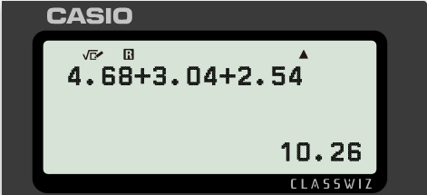
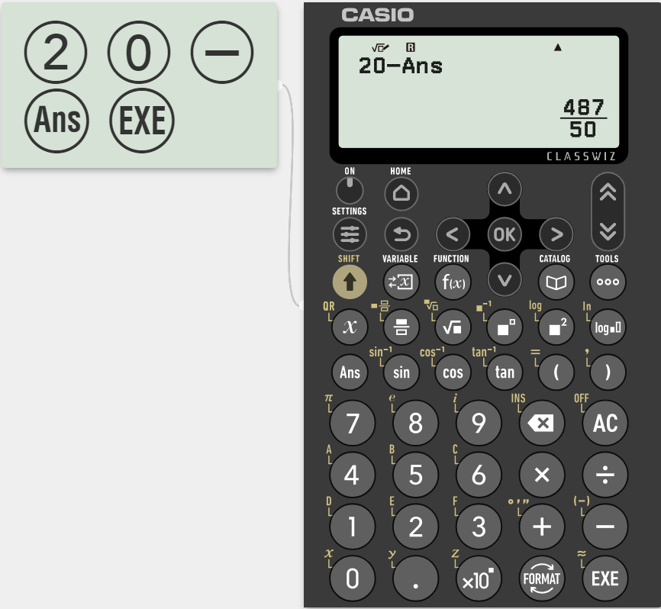
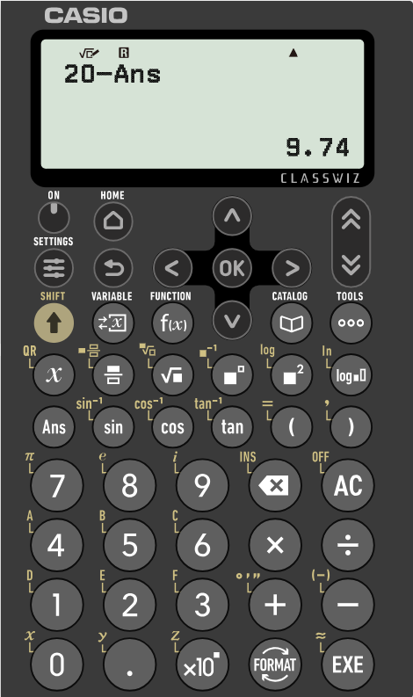
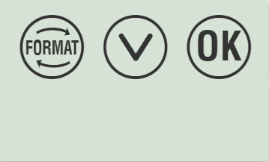
Using a calculator for decimal calculations
Andeep pays for his pens and pencils with a £20 note.
How much change does he get?
Total cost = 4.68 + 3.04 + 2.54
This is the calculation to find the total cost.

Slide 26
Using a calculator for decimal calculations
Work out the total cost of 2 of each.
£157.66
£1.56
76p
£1.27
£7.18
£7.16

Slide 27
Using a calculator for decimal calculations
Work out the cost of the following:
5 pens and 2 pencils
4 pens, 6 pencils and 1 highlighter
1 pen, 4 pencils and 5 highlighters
12 pencils and 6 highlighters
8 pens, 5 pencils and 3 highlighters
175 of each
£1.56
76p
£1.27

Slide 28
Using a calculator for decimal calculations
Work out the cost of the following:
5 pens and 2 pencils £9.32
4 pens, 6 pencils and 1 highlighter £12.07
1 pen, 4 pencils and 5 highlighters £10.95
12 pencils and 6 highlighters £16.74
8 pens, 5 pencils and 3 highlighters £20.09
175 of each £628.25
£1.56
76p
£1.27

Slide 29
Securing understanding of arithmetic procedures with integers and decimals
It is very important to consider if your answers are reasonable.
An answer can be checked to see if it appears to be too big or small.
Using a calculator does not guarantee the correct answer. Always check what you have inputted.
Using the ‘Ans’ button can be more efficient and can allow for greater accuracy.

Slide 30

© Oak National Academy 2023.
Produced in partnership with Mathematics in Education and Industry.
Licensed on the Open Government Licence v3.0, except where otherwise stated. See Oak terms and conditions.

